Slide 1
Operators in Python

Slide 2
Python divides the operators into the following seven groups:
Arithmetic operators
Assignment operators
Comparison operators
Logical operators
Identity operators
Membership operators
Bitwise operators

Slide 3
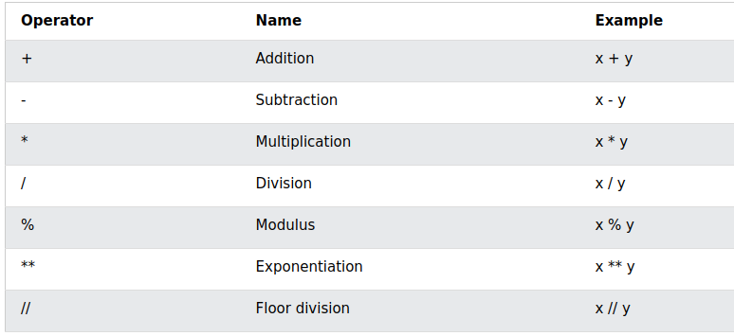
Arithmetic operators

Slide 4
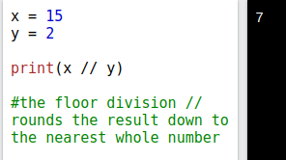
Floor Division

Slide 5
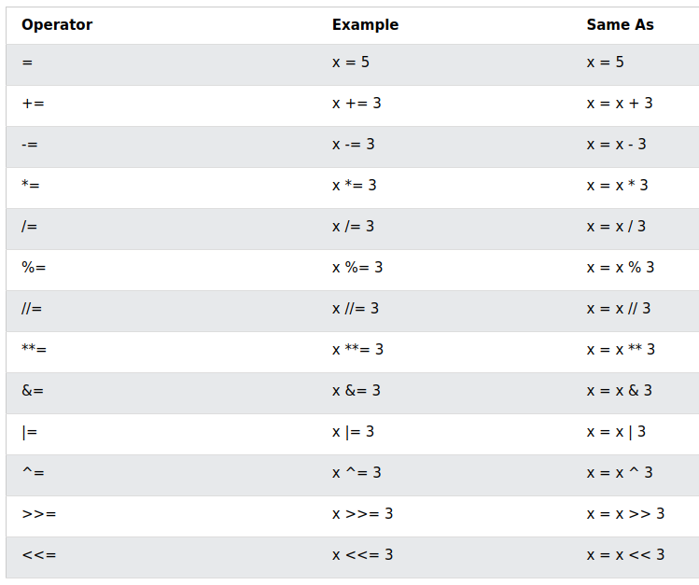
Assignment Operators
Python does not have ++ (as in i++) operator.
If you want to increment a variable:
x += 1

Slide 6
Assignment Operator (Problem)
What is the output of this program?
x = 5
y = 10
x = y
print(x)
print(y)

Slide 7
Assignment Operator (Solution)
What is the output of this program?
x = 5 # x is the variable name. Explicit value being passed is 5.
y = 10 # y is the variable name. Explicit value being passed is 10.
x = y # Variable which is taking the value is on the left. X is taking the value. And value being passed is 10 through y.
print(x)
print(y)

Slide 8
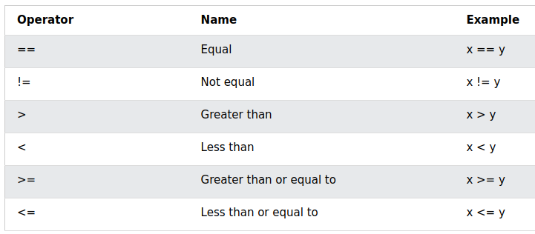
Comparison Operators

Slide 9
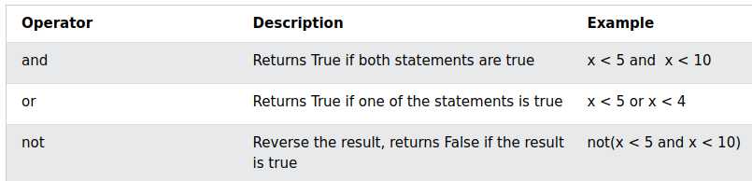
Logical Operators
“and” in C++ is: &&
“or” in C++ is: ||

Slide 10
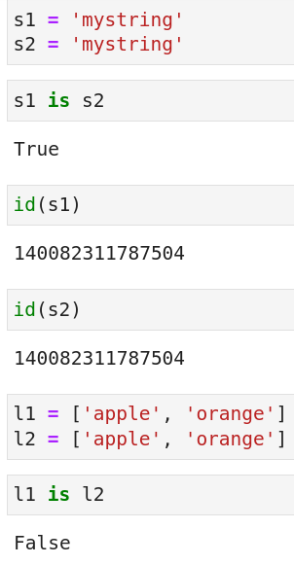
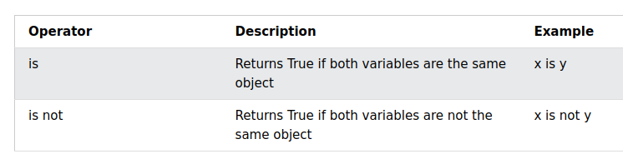
Identity Operators

Slide 11
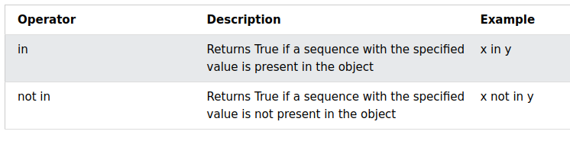
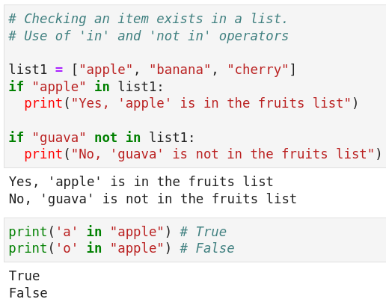
Membership Operators

Slide 12
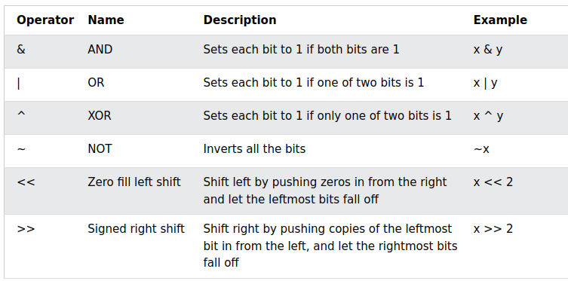
Bitwise Operators

